Slide 1

Connecting to External Data in Docassemble

Slide 2
Some Examples
Legal Server jQuery: https://gbls-demo.legalserver.org
Legal Server API: to be continued? https://github.com/samharden/legalserverapi, https://gbls.legalserver.org/matter/api/matter_search/?token=washington
Address Autocomplete: https://interviews-dev.gbls.org/interview?i=docassemble.playground1%3Aaddress_example.yml
https://catfact.ninja/fact

Slide 3

First, Some Computer science Syntax
Functions
Classes / Object Oriented Programming
Lists and Dictionaries

Slide 4
What is a Function?
A stored procedure or series or steps
May have one or more parameters separated by commas
May have “side effects” or be a pure function
def add(x,y):
return x + y
add(5,1) == 6

Slide 5
Some Docassemble Functions
capitalize(text): changes text to uppercase
interview_url(): returns a link to the current interview session
states_list(): returns a list of state names you can use in a multiple choice question
https://docassemble.org/docs/functions.html

Slide 6
World’s Smallest Introduction to Object-Oriented Programming
A Class is a custom data type
Classes can have attributes and methods
An Object is an instance of a Class
income_list.total()
my_income.employer
https://www.nonprofittechy.com/2018/09/12/object-oriented-programming-for-document-assembly-developers/

Slide 7
Some Docassemble Classes
Individual: has a first, middle and last name, address, salutation
Address: can be geolocated to fill in missing information
Income and IncomeList: makes it simple to work with wage/non-wage income
https://docassemble.org/docs/objects.html

Slide 8
Lists and Dictionaries
A list is an ordered collection of variables: [“first”,“second”]
Elements are retrieved with a numeric index that starts at 0. List[0] == “first”
A dictionary is a lookup table with keys and values: {key1: value1,key2: value2}
Elements are retrieved with the key. Dict[‘key1’] == value1
Both dictionaries and lists can be extended at runtime in Python / Docassemble
my_rocks[0] == “Basalt”
company_roles[‘ED’] == “Jacqui”

Slide 9
Three Ways to Work with External Data
Receive data in a URL
Create a special URL to encode data
Retrieve information via an API

Slide 10
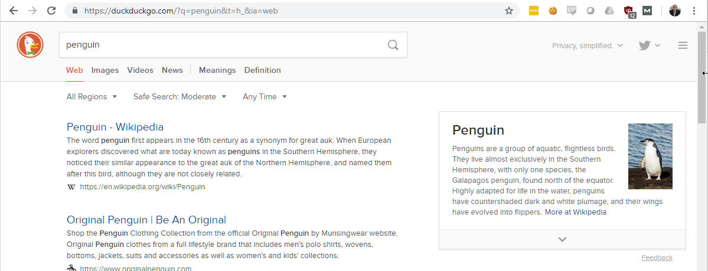
What goes into a URL?
https:// duckduckgo.com / ?q=penguin&t=h_&ia=web
protocol domain path query string

Slide 11
Query Parameters
? To mark the beginning of the parameter list
A variable name
=
The value
Optional additional parameters separated by &
?q=penguin&t=h_&ia=web

Slide 12
Use a URL parameter in a Docassemble Interview
https://interviews.gbls.org/interview?i=docassemble.MAEvictionDefense%3Adata%2Fquestions%2Feviction.yml#page9
Remove anything after the # symbol
Add a second parameter with &
Access it in Docassemble with the special dictionary url_args
url_args[‘parameter_name’] url_args.get(‘parameter_name’, ‘default’)
https://www.programiz.com/python-programming/methods/dictionary/get
https://docassemble.org/docs/special.html#url_args

Slide 13
Create a new URL Parameter
interview_url(parameter=value)
https://docassemble.org/docs/functions.html#interview_url

Slide 14
What is an API?
An API is analogous to a function that runs on an external web server
Most APIs return formatted data (JSON is currently popular, analogous to YAML)
Making an API request is usually as simple as sending special URL arguments
URL Query Parameters
API
Your Website
Remote Server
JSON Response
https://www.upwork.com/hiring/development/intro-to-apis-what-is-an-api/

Slide 15
Some Interesting APIs
https://github.com/samharden/legalserverapi
https://github.com/toddmotto/public-apis
https://github.com/abhishekbanthia/Public-APIs
http://developer.kbb.com/: Price cars?
https://www.zillow.com/howto/api/APIOverview.htm: Price houses, neighborhood boundaries
https://developers.google.com/maps/documentation/

Slide 16

Time for a Cat
https://api.thecatapi.com/v1/images/search
http://jsoneditoronline.org/

Slide 17
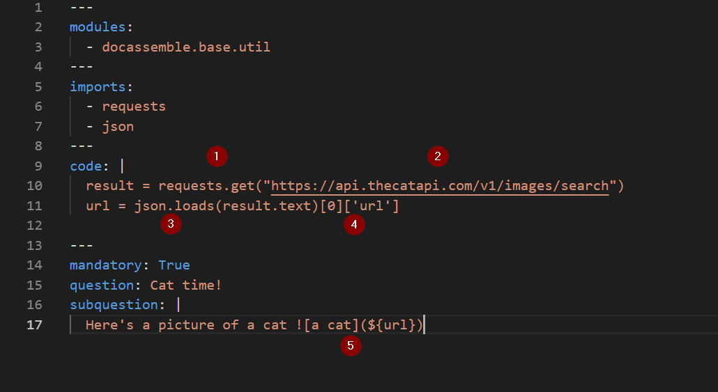
Using the API Call

Slide 18
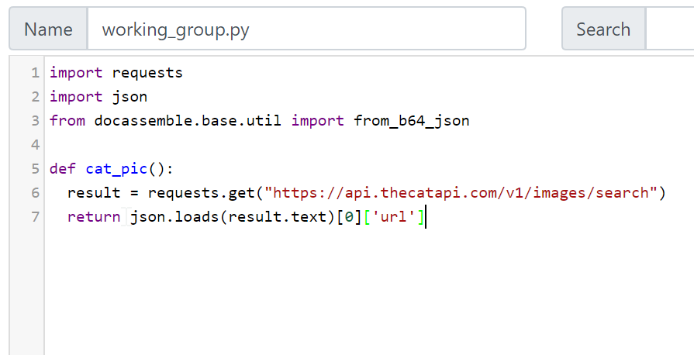
Wrapping it in a Function

Slide 19
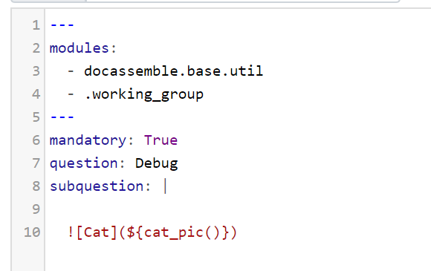
Use our New Module

